Slide 1

Insights into designing, occupying and managing an NZEB
Rajan Rawal
Yash Shukla
Centre for Advanced Research in Building Science and Energy, CEPT University

Slide 2
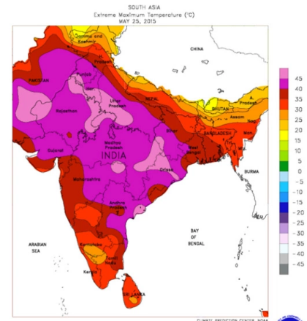
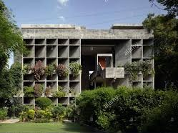

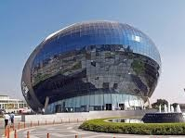
CONTEXT : India
Energy Consumption for space-cooling in India (ICAP)
135 TWh (2017-18)
600 TWh (2037-38)
Per Capita Cooling Consumption (ICAP)
272 kWh Global Average
69 kWh in India
30% of global emissions due to space cooling by 2050 as compared to 8% in 2016 (IEA)
Image Source: https://robertscribbler.com/2015/06/02/human-hothouse-death-toll-climbs-to-2300-in-india-monsoon-suppressed-delayed/
Notes:
Image source: https://robertscribbler.com/2015/06/02/human-hothouse-death-toll-climbs-to-2300-in-india-monsoon-suppressed-delayed/

Slide 3


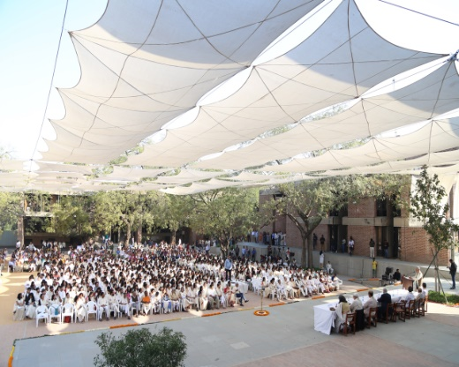
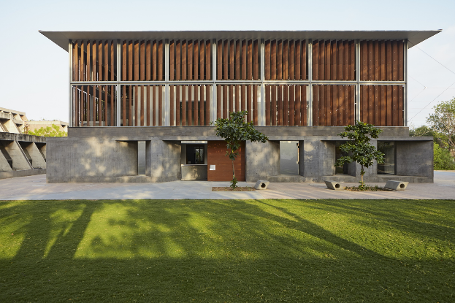
CONTEXT : CEPT Uni, Ahmedabad
Ahmedabad - UNESCO World Heritage City
Significant place for Modern Movement in Indian Architecture
CEPT University – A habitat university
understanding,
designing,
planning,
constructing.

Slide 4

Centre for Advanced Research
in Building Science and Energy
Centre for Advanced Research in Building Science and Energy
Research activities
Building Physics – Material Characterization
Thermal Comfort
Low Energy Cooling
Modelling and Simulation
IT in Buildings, Sensors and Control
Design – Technology - Policy

Slide 5
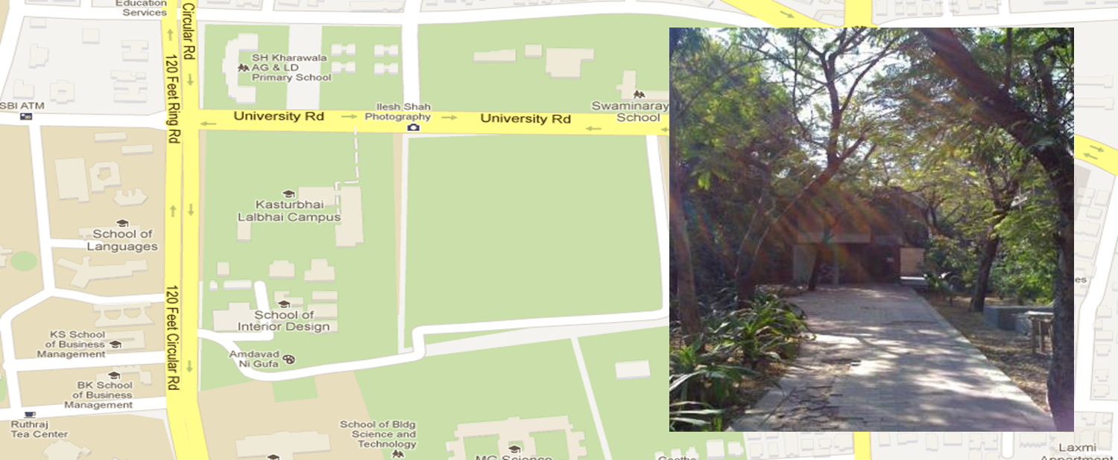
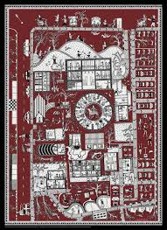
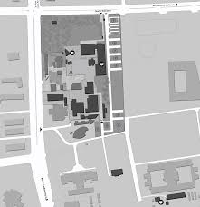
Site: CEPT Campus, Hussain and Doshi Gufa

Slide 6
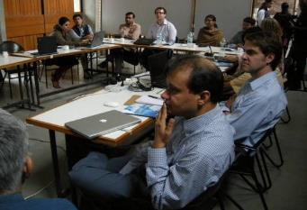
CARBSE – Iterative Design Process
Predesign
  Climate Analysis
  Technical Potential Analysis
Conceptual Design
  Passive Thermal Comfort
  Building Massing
  HVAC System Options
System Development
  Section, Windows, Shading, Daylighting
  Active System Thermal Comfort
  HVAC Capacity Optimization
  Natural Ventilation Scheduling, CFD
Systems Optimization
Three in-person charrettes in Ahmedabad
Over 50 virtual meetings and presentations

Slide 7


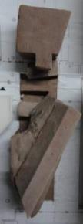
CARBSE – Building Massing Exercise
Basis of Design for Energy Performance

Slide 8
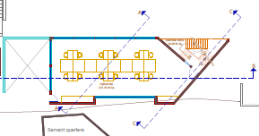
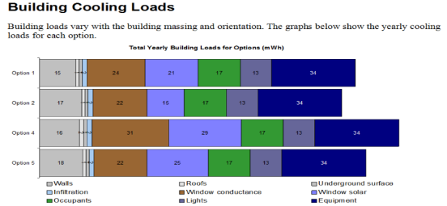
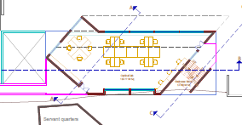
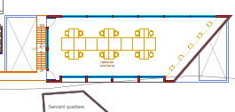
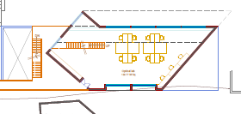
CARBSE – Building Massing Exercise
Option 1
Option 2
Option 3
Option 4

Slide 9
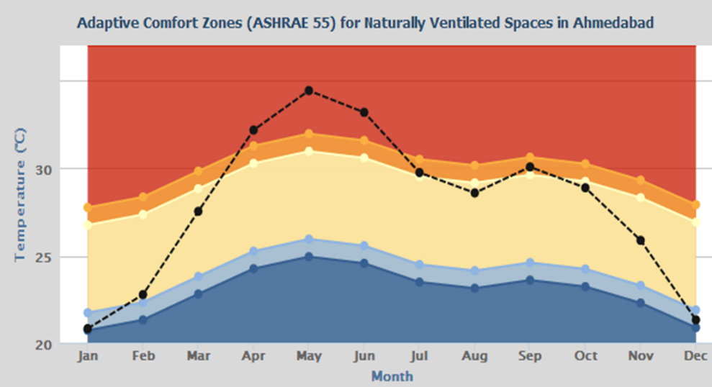
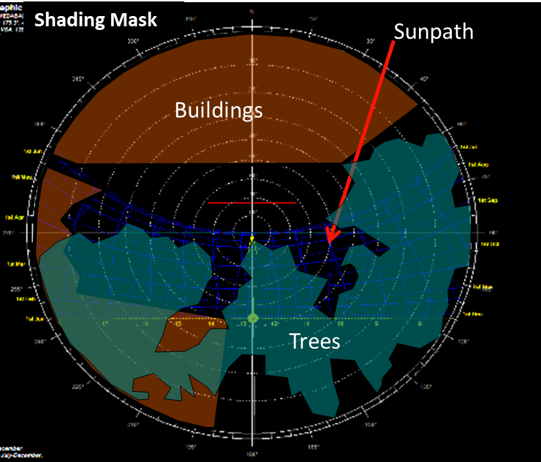
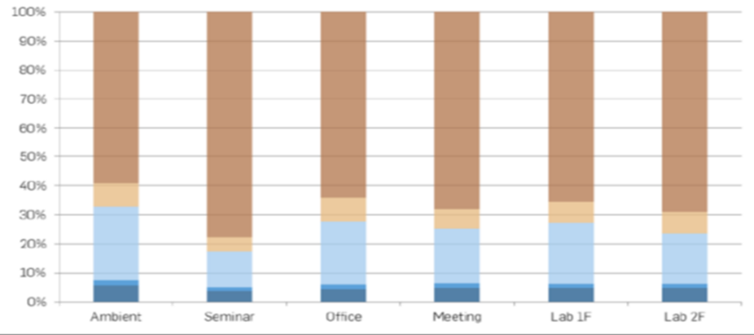
CARBSE – Passive Design Approach

Slide 10
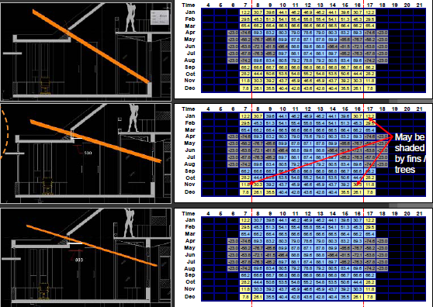
CARBSE – Sun Control : South Facing Clerestory
Base Case
No light shelf
(70 deg cut-off)
Option 1
500 light shelf
(39 deg cut-off)
Option 2
800 light shelf
(30 deg cut-off)

Slide 11
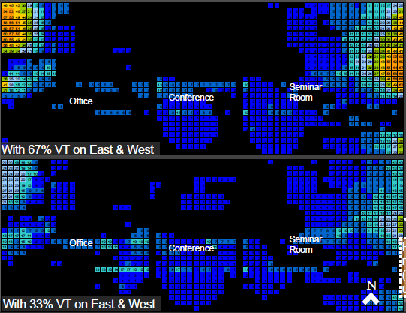
CARBSE – UDI Analysis (>2000) on Work Plane
Reduced VT reduced UDI(>2000) by UP TO 30% !

Slide 12
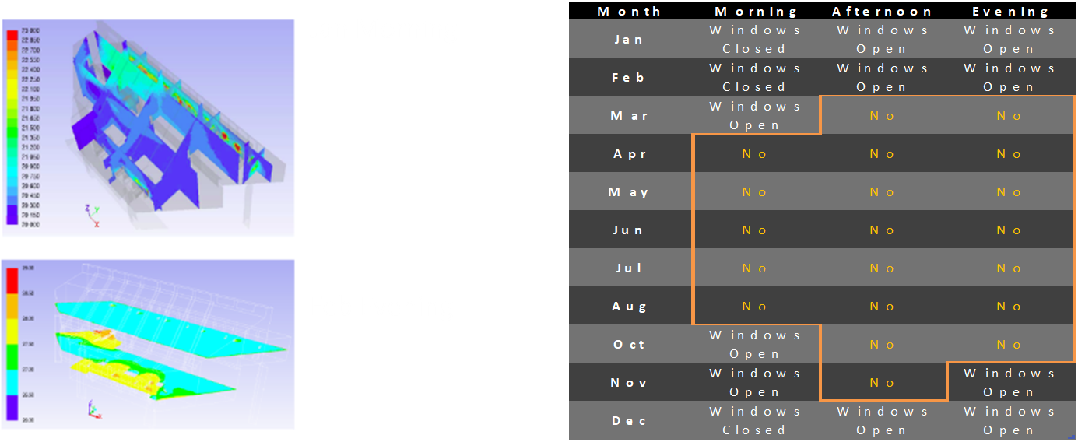
CARBSE – Thermal Comfort and NV Potential
Jan Morning
Feb Evening

Slide 13
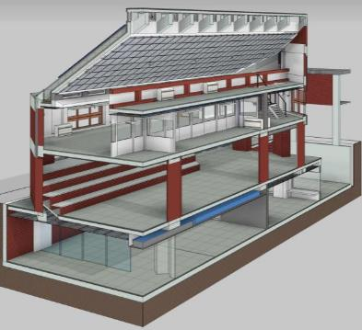
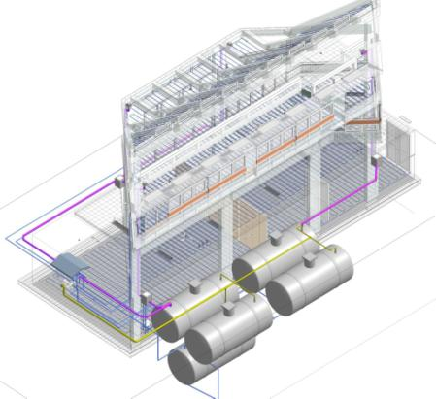
CARBSE – Building Information Modelling

Slide 14
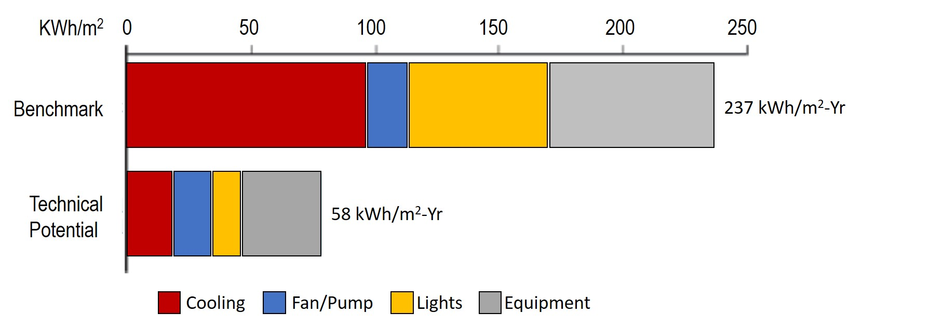
CARBSE – Net Zero Energy Building

Slide 15
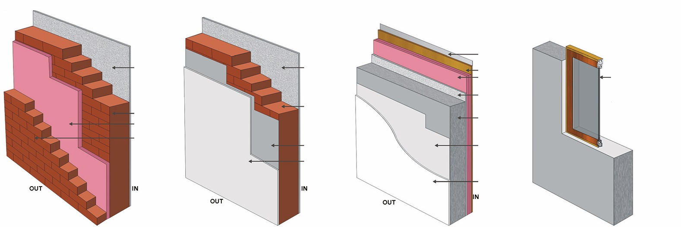
CARBSE – Wall Construction
3.1 WALL SUPER STRUCTURE
u - VALUE (W/m ²)=0.42
R - VALUE (m ².K/W)=2.38
3.2 WALL BASEMENT
u - VALUE (W/m ²)=2.01
R - VALUE (m ².K/W)=0.50
3.3 WALL BASEMENT
u - VALUE (W/m ²)=0.28
R - VALUE (m ².K/W)=3.59
3.4 WINDOW
u - VALUE (W/m ²)=1.70
R - VALUE (m ².K/W)=0.588
3mm Aluminum
Composite Panel
12mm Cement
Plaster
12mm Cement
Plaster
18mm Plywood
100mm X.P.S Insulation
Low E Double Glass Glazing With UPVC Frame
VLT - 39%
Reflection int - 14%
External -23%
SF - 29%
SC - 0.33
U-Value - 1.790W/m ² k
12mm Cement
Plaster
230mm Red Brick
230mm Red Brick
50mm X.P.S Insulation
110mm Red Brick
200mm R.C.C.
1mm PVC Film
1mm PVC Film
18mm Polymer
Plaster
18mm Polymer
Plaster

Slide 16
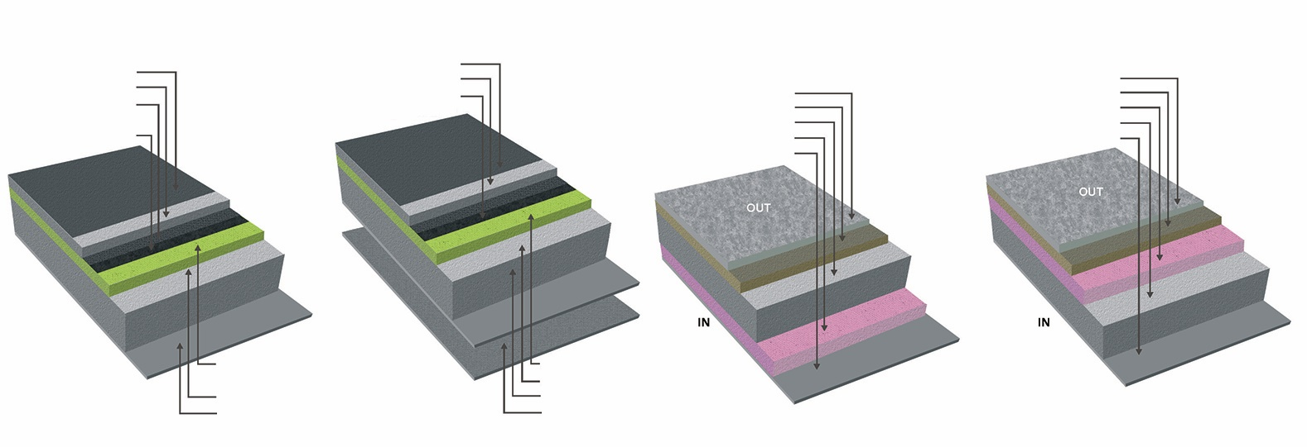
CARBSE – Roof Construction
1.1 ROOF ASSEMBLY
u - VALUE (W/m²)=0.38
R - VALUE (m ².K/W)=2.654
1.2 ROOF ASSEMBLY
u - VALUE (W/m ²)=0.38
R - VALUE (m ².K/W)=2.654
2.1 FLOOR- First Floor
u - VALUE (W/m ²)=0.55
R - VALUE (m ².K/W)=1.82
2.2 FLOOR- First Floor
u - VALUE (W/m ²)=0.55
R - VALUE (m ².K/W)=1.82
2mm High SRI Paint
50mm Concrete Screed
2mm Roof Seal- Water
Proofing Membrane
3mm Geotextile Sheet
2mm High SRI Paint
50mm Concrete Screed
2mm Roof Seal- Waterproofing Membrane
25mm Kota Stone
50mm Cement Sand Bed
50mm X.P.S. Insulation
150mm R.C.C.
12mm Cement Plaster
25mm Kota Stone
50mm Cement Sand Bed
150mm R.C.C.
50mm X.P.S. Insulation
6mm Feweis Plaster
45mm Spray Foam Insulation(PUF)
150mm R.C.C.
12mm Plaster
3mm Geotextile Sheet
45mm Spray Foam Insulation(PUF)
150mm R.C.C.
12mm Plaster

Slide 17
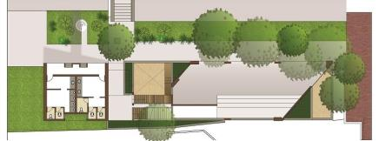
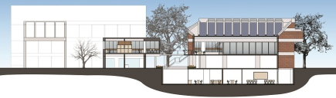
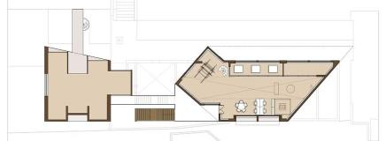
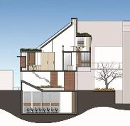
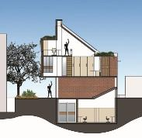
CARBSE – Net Zero Energy Building
Longitudinal Section
Ground Floor Plan
First Floor Plan
Transverse Section A
Transverse Section B

Slide 18
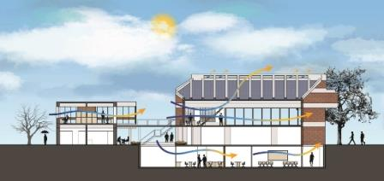
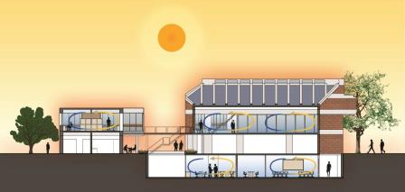
CARBSE – Net Zero Energy Building
Comfortable Outdoor Environment
Hot Outdoor Environment

Slide 19
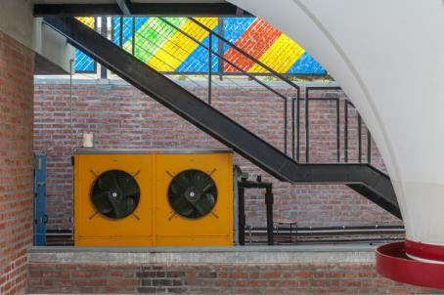
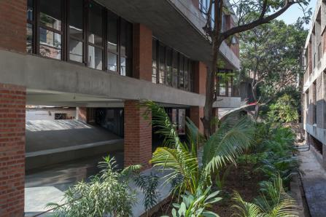
CARBSE – Net Zero Energy Building

Slide 20
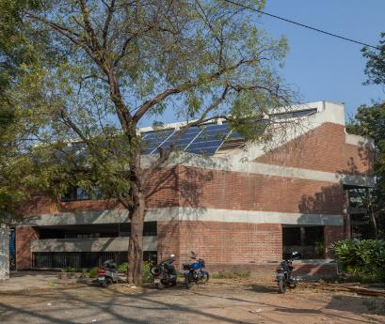
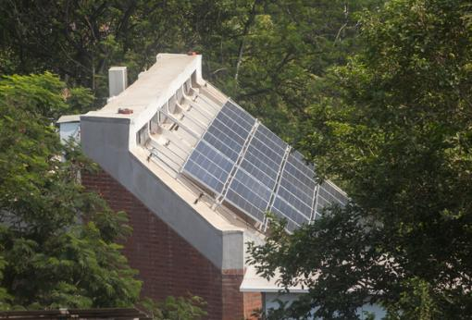
CARBSE – Net Zero Energy Building

Slide 21
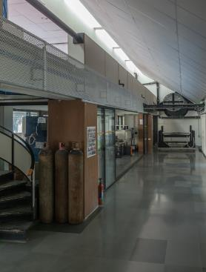
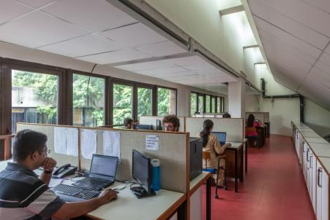
CARBSE – Net Zero Energy Building

Slide 22
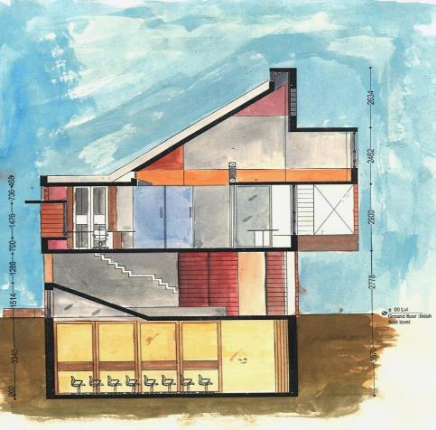
CARBSE – Net Zero Energy Building
Integrated Systems
North light for daylighting
South facing PV panels tilted to latitude angle
N
Radiant cooling and DOAS integrates with natural ventilation
Vision, clerestories, lightshleves on south bring in diffuse daylight with occupant control
Lighting LPD at 4.7 w/m2 and vacancy and daylighting controls
Stack effect design, solar chimney for natural ventilation
Climate controlled spaces zoned separately
Outdoor exhibit area reduces conditioned area
Optimized envelope: Insulated walls and roof, efficient windows with separate properties for vision and clerestory
Ground heat exchange

Slide 23

CARBSE – Net Zero Energy Building
Promotor
Architects - Designer
Contractor
Operation and Maintenance

Slide 24

CARBSE – Monitoring Strategies
“Every line is the perfect length if you don't measure it”
-Marty Rubin

Slide 25
CARBSE – Monitoring Strategies
Building Information Systems
Thermal Comfort, Temp – Humidity
Visual Comfort, Light
Occupancy
Outdoor conditions
Equipment usage
Building Management Systems
Energy Management
  Energy used to maintain comfort
  Energy used for equipment

Slide 26
CARBSE – Monitoring Strategies
Monitoring
Integration
Controls
Display
Envelope
Chiller
HVAC
Operation
Environment
HVAC
Lighting
Comfort
Energy
VFD
Plug Loads
Consumption
Behavior
Photovoltaic
Photovoltaic
Generation
Outdoor
Operation
Historical

Slide 27
CARBSE – Monitoring Strategies
Building Control System
Energy Meters
Communication Gateway
Sensors and Controllers
Lighting
Chillers
Radiant
VRF
Chilled Plant
VRV Units
DOAS
Digital Scrolls
Fans
Envelope
Guarded Hot Box
Photovoltaic
Comfort Chamber
Monitoring and Integration
Controls Hardware

Slide 28
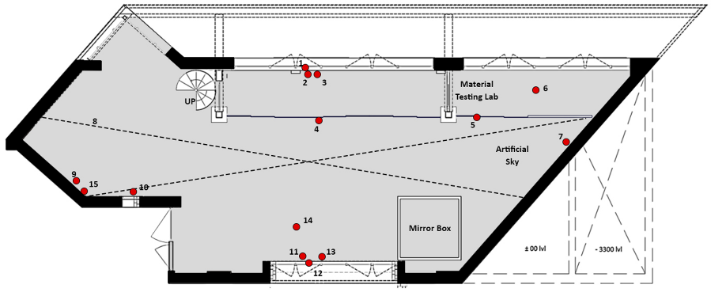
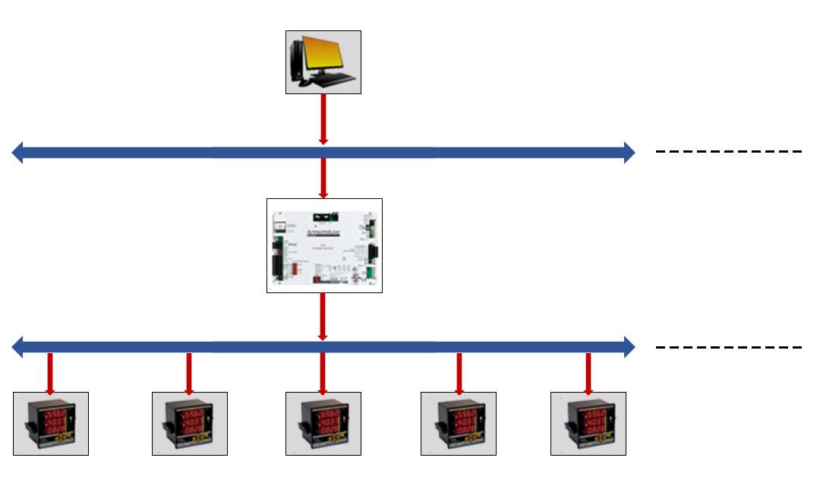
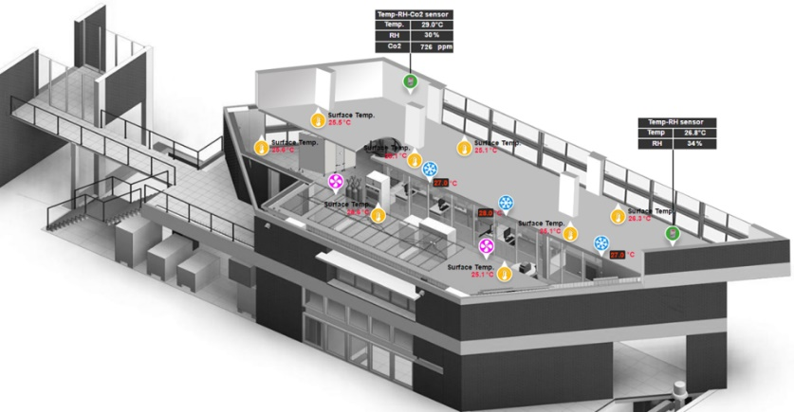
CARBSE – Monitoring Strategies
Monitoring &
Management
Computer
Wire/Wireless
Communication
Station level
management
tier
Sensor Location Example
Communication
Gateway (LGR-
Automated Logic)
Network
Communication
tier
Modbus (RS485)
Field
Space tier
Energy Meters
BMS Screen shot

Slide 29
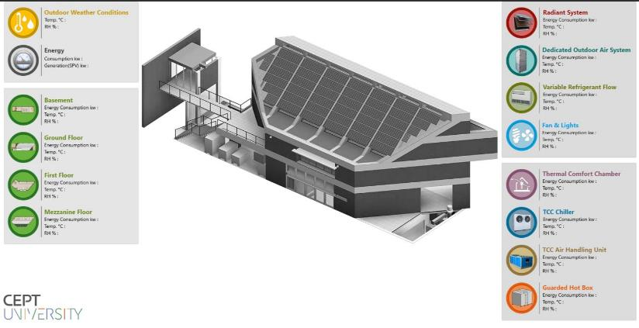
CARBSE – Monitoring Strategies

Slide 30
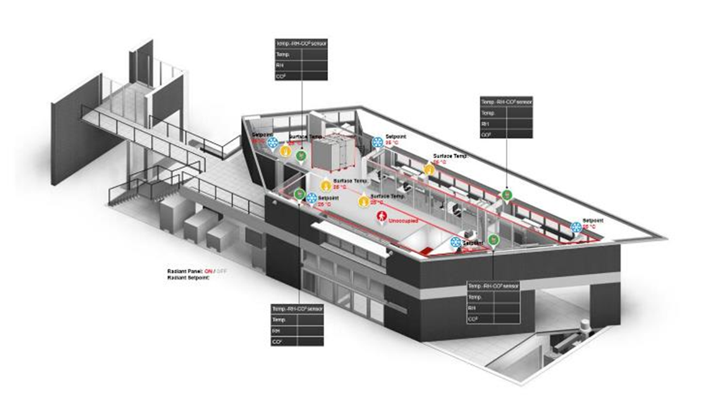
CARBSE – Monitoring Strategies

Slide 31
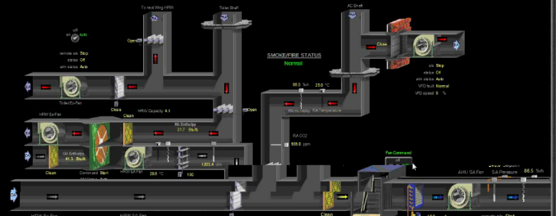
CARBSE – Monitoring Strategies
Approximately 1000 points – Indoor Environment – Energy Consumption – Energy Generation – Outdoor weather conditions – End use, lighting, HVAC, Plug and Process.

Slide 32
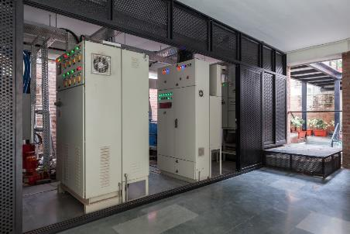
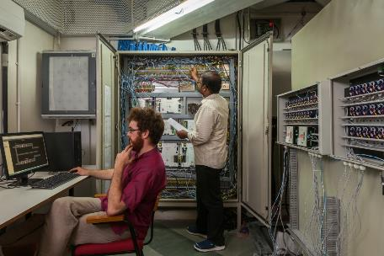
CARBSE – Monitoring Strategies

Slide 33
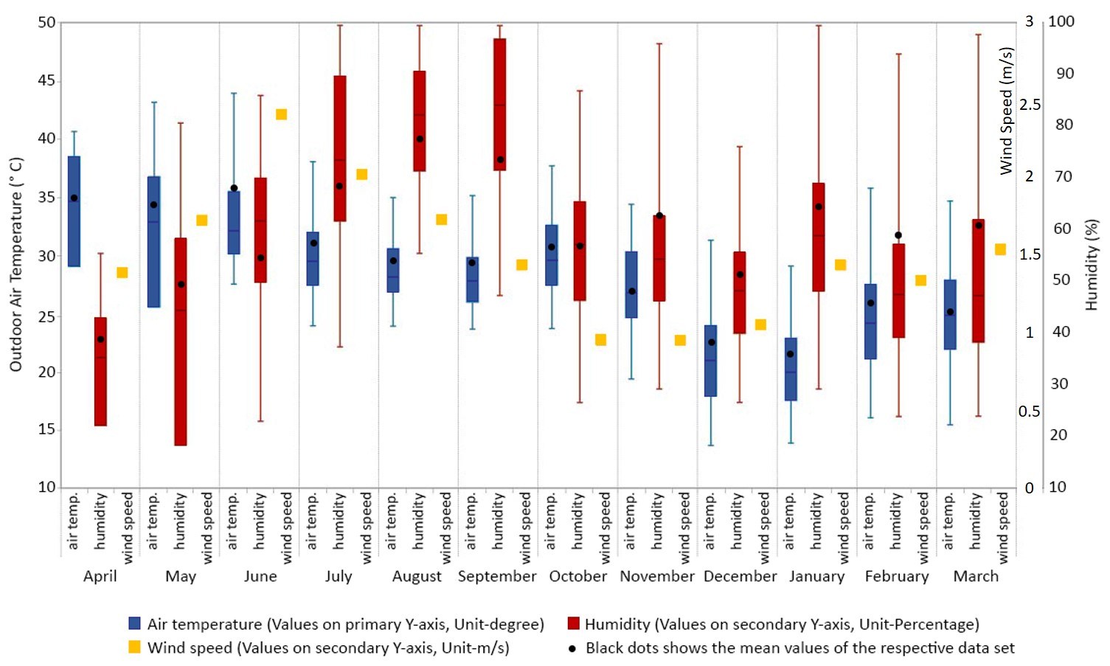
CARBSE – Outdoor Conditions

Slide 34
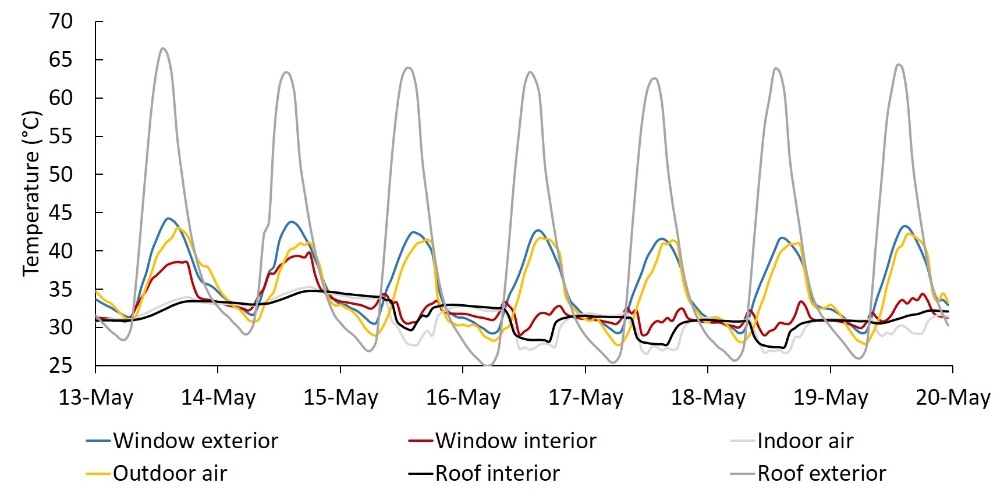
CARBSE – Outdoor & Indoor comparison
Interior and exterior surface temperatures for the window and roof – typical summer week (2018)

Slide 35

CARBSE – Indoor Environment and Energy
Environment and energy-related parameters – typical summer week (2018)

Slide 36

CARBSE – Indoor Environment and Energy
Environment and energy-related parameters – typical winter week (2018)

Slide 37

CARBSE – Hourly Energy consumption - Annual
Hourly space energy consumption for each day

Slide 38
CARBSE – Annual Energy Consumption

Slide 39

CARBSE – Outdoor Air temp with Daily Energy: Annual
Total daily space consumption with daily average outdoor temperature (2017-2018)

Slide 40

CARBSE – Outdoor Air temp & Indoor Air Annual
Variation of hourly indoor and outdoor temperatures with the mode of cooling (2017-2018)

Slide 41

CARBSE – Annual Energy Consumption - EPI
Energy generation, process consumption, and space consumption (2016-17) with operation and cooling loads

Slide 42

CARBSE – Annual Energy Consumption
Energy generation, process consumption, and space consumption with operation and cooling loads

Slide 43

CARBSE – Occupant Comfort Surveys
Four times a week, Mondays and Thursdays, 11h00 and 16h00
Occupants have choice to raise request for adjustment anytime
Air Temp, RH, MRT, Clo. and MET at each cluster, Provision of desk level personal fans, pedestal fans.
Seven point ASHRAE Scale
  Thermal Comfort Sensation
  Thermal Comfort Satisfaction
  Thermal Comfort Preference

Slide 44

CARBSE – Thermal Comfort, Adaptive Model
Indoor temperature against IMAC 80% and 90% acceptability limits (2017-2018)

Slide 45

CARBSE – Thermal Comfort, Adaptive Model
Thermal sensation and acceptability versus indoor air temperature

Slide 46

CARBSE – Thermal Comfort, Adaptive Model
Thermal comfort versus temperature

Slide 47









CARBSE – NZEB Partners
Owens Corning
Asahi India Glass
ECOPHIT SGS – Uponor
Sashwath Clean Energy
Citizen Industries
Yogi Engineers
Volpak Systems
United Technologies - Automated Logic

Slide 48
Thank You rajanrawal@cept.ac.in yash.Shukla@cept.ac.in

